Slide 1
Uzumaki Health
Santiago Garcia, Victoria Finn, Brandon Lawson

Slide 2
About Uzumaki Health
Uzumaki Health (uzumaki-usf.com) is a medical billing website that is compliant with HIPAA and PCI-DSS. The goal is to protect the customers’ PHI and cardholder data to the best of our ability. The website was developed with security as a top priority.

Slide 3
Checklist part 1
Completed original website configuration
Purchased third party hosting and deployed server
Purchased domain name and configured DNS records
Installed cyberpanel
Installed SSL Certificate
Configured UFW Firewall
Setup Mail Hosting with Zoho
Created website navigation bar
Created Contact Us Page and connected it with GetForm
Created Payment Form and connected it with Stripe
Created website databases and connected them to the frontend
Implemented primary key system that auto increments for users table
Implemented Captchas on all forms
Researched HIPAA and PCI-DSS to become compliant
Website testing and troubleshooting

Slide 4
Checklist part 2
Configuration troubleshoot log
Created MyHealth page
Vaccination Records: SQL table, php, html, css
Prescription Records: SQL table, php, html, css
Billing: Invoice, SQL table, php, html css
Appointment: SQL table, php, html, css
Created Profile page
Embedded PHP to pull information from SQL database
Accuracy of results, PHP SQL Statements
Created Primary and Foreign keys in database tables
Created the Login Page
Created the Registration Page
Created the About Us Page
Created the Reset Password Page and function
Created the Logout function
Created PHP function to make it so only signed in users can use the website

Slide 5
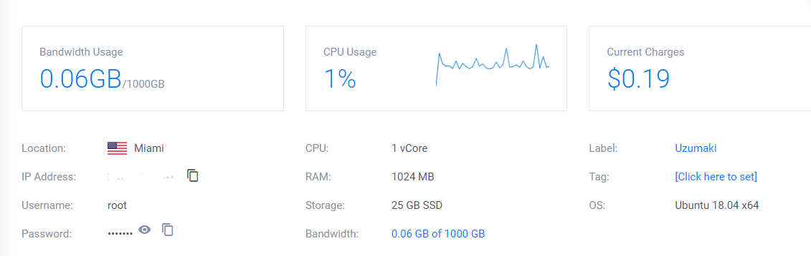
Development Phases
Purchase web hosting and deploy web server.
Install CyberPanel to for website management.
Install SSL Certificate and configure UFW Firewall

Slide 6
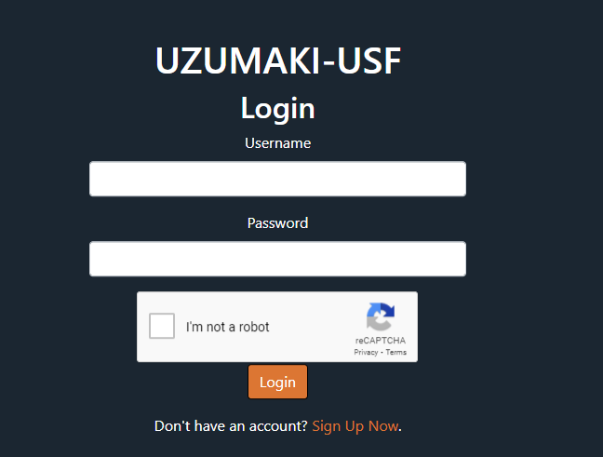
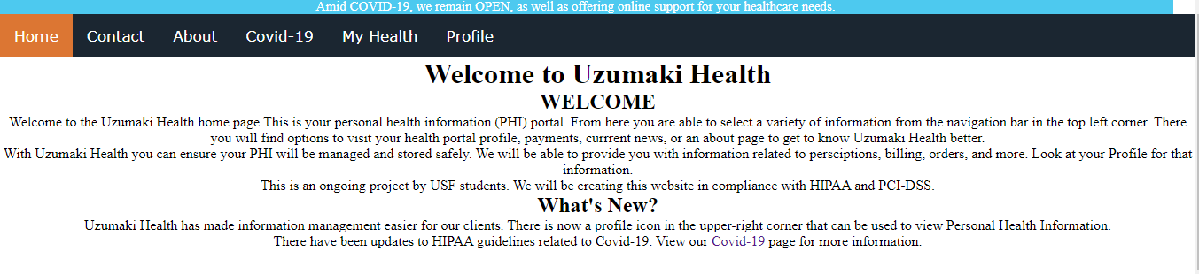
Development Phases
4. Create website anatomy.
The website is locked behind a login page, if a user tries to go to any other page in the site, they will be redirected back to login.
Once a user logs in, they are greeted with the Home page and navigation bar.

Slide 7
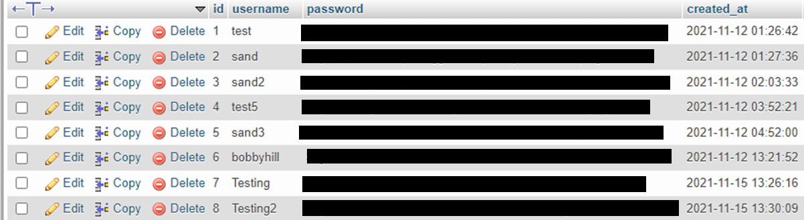
Development Phases
5. Connect website to database.
There are two sections of the website that are connected to the database, the Login page and the My Health page.
The login page works from a users table that uses an ‘id’ field as a primary key that auto increments each time a new user is created.

Slide 8
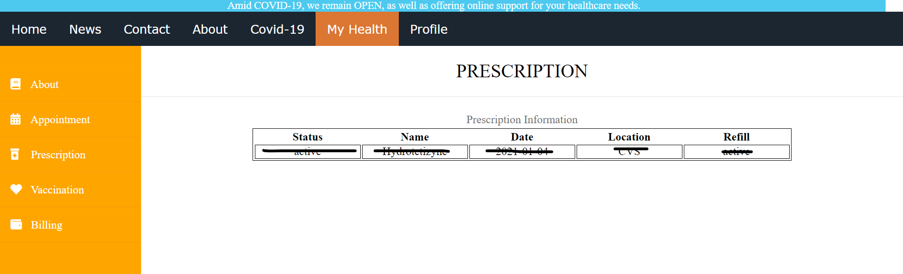
Development Phases
5. MyHealth Webpage
MyHealth is a collection of webpages that allow clients to view their personal health information. Here they are able to view prescriptions, vaccinations records, upcoming appointments, and billing. The Billing page allows for PCI-DSS compliant payment options provided through Stripes payment service.

Slide 9
Development Phases
6. SQL Databases, Tables
Through PHPMYADMIN we are able to manage MySQL databases that stores ePHI. We designed a single database uzum_db to store information in a variety of tables. We designed table structures that help provide organization and input validation security. Anywhere a user can input text there will always be input validation restrictions. Passwords are stored hashed with Bcrypt and combined with a unique salt variable to reduce password collision. Information is stored and received through PHP statements that are synced with the active users ID (primary key). We utilize global variables(php), primary keys and foreign keys to ensure that accurate data is being shown user.

Slide 10
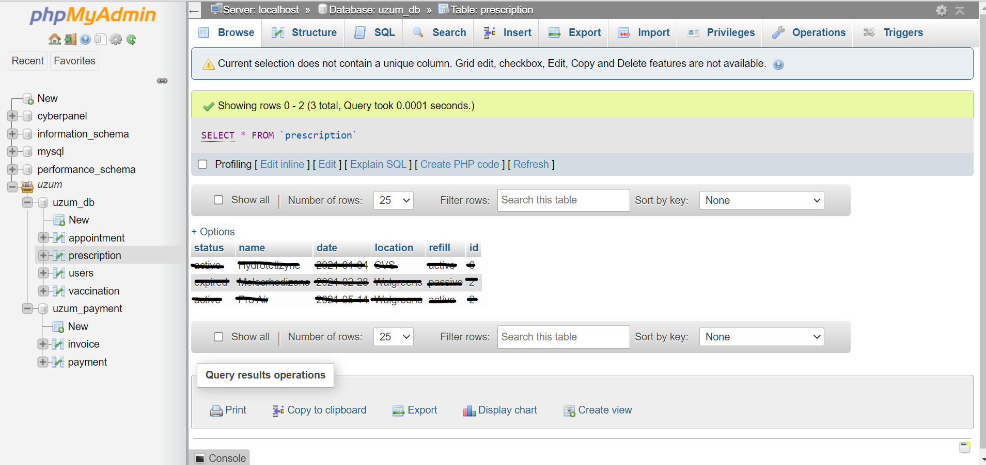
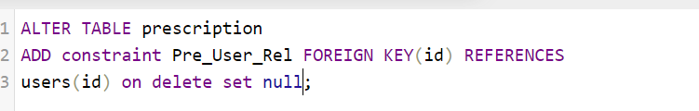
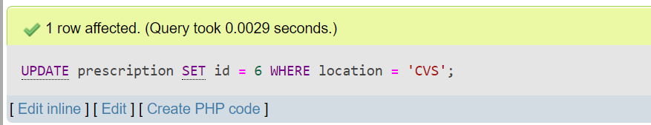
Development Phases
6. SQL Databases, Tables cont…
Creating Foreign Key
Successful Foreign Key Test Statement

Slide 11
Development Phases
7. PHP
We utilize embedded php to transfer ePHI bidirectionally. We define our database variables (db_name, db_password) to be passed in SQL connection parameters providing us a linkage between GUI and the SQL database. Utilizing global variables we are able to maintain session id to ensure the correct corresponding data is presented. SQL Select statements are properly constructed for accurate data management. Input validation is implemented anywhere a user can provide input. We close/disconnect the sql connection after each usage.

Slide 12
Cybersecurity Considerations
User passwords are not stored in cleartext
Each form has a recaptcha implemented to prevent bot attacks
The control panel and SSH login use complex passwords that follow password security standards (capital and lowercase letters, numbers, symbols, minimum length of 16 characters, etc)
Entire website is locked behind a login page
HTML input validation on all forms
3rd party payment processing with Stripe
Automatic logoff within 15 minutes of inactivity

